Slide 1
CPU Scheduling

Slide 2
Contents
Basic Concepts
Scheduling Criteria
Scheduling Algorithms
Thread Scheduling
Multiple-Processor Scheduling
Algorithm Evaluation

Slide 3
Objectives
To introduce CPU scheduling, which is the basis for multiprogrammed operating systems
To describe various CPU-scheduling algorithms
To discuss evaluation criteria for selecting a CPU-scheduling algorithm for a particular system
To examine the scheduling algorithms of several operating systems

Slide 4
Basic Concepts
Maximum CPU utilization obtained with multiprogramming
CPU–I/O Burst Cycle – Process execution consists of a cycle of CPU execution and I/O , wait CPU burst followed by I/O wait

Slide 5
CPU Scheduler
Short-term scheduler selects from among the processes in ready queue, and allocates the CPU to one of them
Preemptive Scheduling
CPU scheduling decisions may take place when a process:
1. Switches from running to waiting state
2. Switches from running to ready state
3. Switches from waiting to ready state
4. Terminates
Scheduling under 1 and 4 is nonpreemptive. otherwise, it is preemptive

Slide 6
Dispatcher
Dispatcher module gives control of the CPU to the process selected by the short-term scheduler.
switching to user mode
switching context
jumping to the proper location in the user program to restart that program
Dispatch latency – time it takes for the dispatcher to stop one process and start another running

Slide 7
Scheduling Criteria
CPU utilization: keep the CPU as busy as possible
Throughput :One measure of work is the number of processes that are completed per time unit, called throughput.
Turnaround time : The interval from the time of submission of a process to the time of completion is the turnaround time.
Waiting time : The amount of time a process has been waiting in the ready queue
Response time : The amount of time it takes from when a request was submitted until the first response is produced, not output(for time-sharing environment)

Slide 8
Scheduling Algorithm Optimization Criteria
Max CPU utilization
Max throughput
Min turnaround time
Min waiting time
Min response time

Slide 9
Scheduling Algorithms
First-Come, First-Served (FCFS) Scheduling
Shortest-Job-First (SJF) Scheduling
Shortest-remaining-time-first
Priority Scheduling
Round Robin (RR)

Slide 10
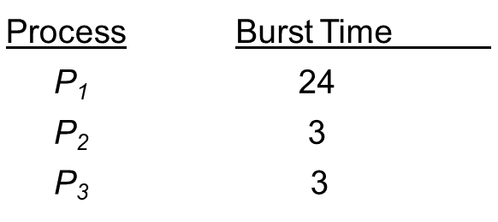
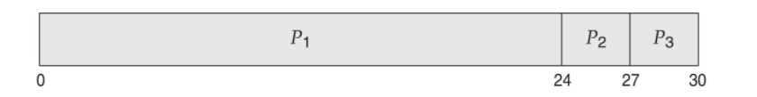
First-Come, First-Served (FCFS) Scheduling
Suppose that the processes arrive in the order: P₁ , P₂ , P₃
The Gantt Chart for the schedule is:
Waiting time for P₁= 0; P₂= 24; P₃ = 27
Average waiting time: (0 + 24 + 27)/3 = 17 milliseconds.

Slide 11
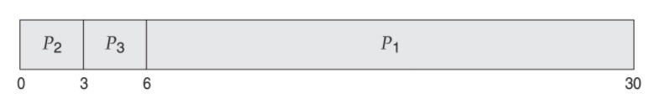
Contd..
Suppose that the processes arrive in the order: P₂ , P₃ , P₁
The Gantt chart for the schedule is:
Waiting time for P₁ = 6; P₂ = 0; P₃ = 3
Average waiting time: (6 + 0 + 3)/3 = 3 millisecond
Much better than previous case
Convoy effect - short process behind long process Consider one CPU-bound and many I/O-bound processes

Slide 12
Shortest-Job-First (SJF) Scheduling
Associate with each process the length of its next CPU burst
Use these lengths to schedule the process with the shortest time
SJF is optimal – gives minimum average waiting time for a given set of processes
The difficulty is knowing the length of the next CPU request

Slide 13
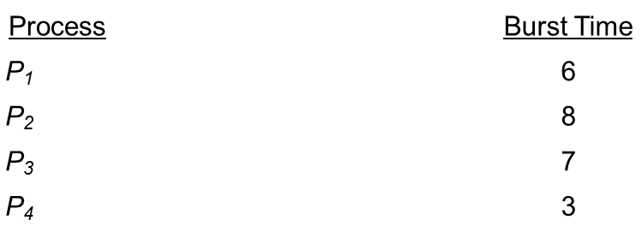
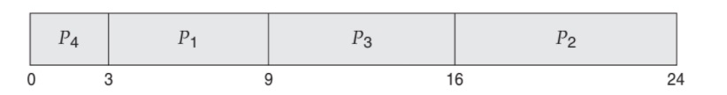
Example of SJF
SJF scheduling chart :
Average waiting time = (3 + 16 + 9 + 0) / 4 = 7 milliseconds

Slide 14
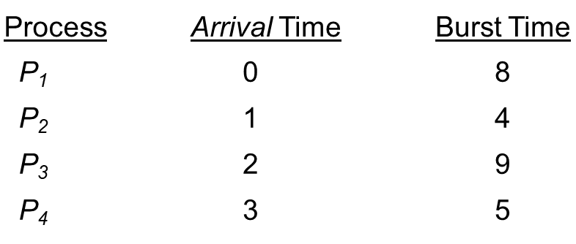
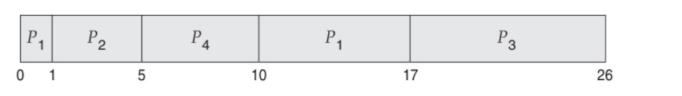
Example of Shortest-remaining-time-first
Now we add the concepts of varying arrival times and preemption to the analysis
Preemptive SJF Gantt Chart :
Average waiting time = 6.5 msec

Slide 15
Priority Scheduling
A priority number (integer) is associated with each process
The CPU is allocated to the process with the highest priority (smallest integer = highest priority)
Preemptive
Nonpreemptive
SJF is priority scheduling where priority is the inverse of predicted next CPU burst time
Problem : Starvation – low priority processes may never execute
Solution : Aging – as time progresses increase the priority of the process

Slide 16
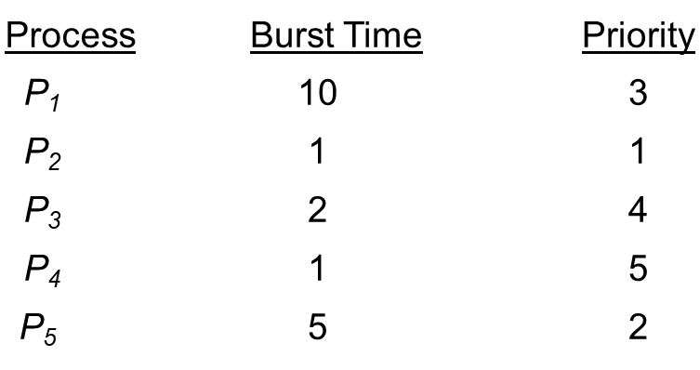
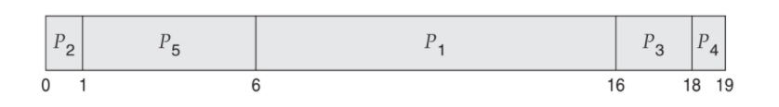
Example of Priority Scheduling
Priority scheduling Gantt Chart :
Average waiting time = 8.2 msec

Slide 17
Round Robin (RR)
Each process gets a small unit of CPU time (time quantum q), usually 10-100 milliseconds.
After this time has elapsed, the process is preempted and added to the end of the ready queue.
If there are n processes in the ready queue and the time quantum is q, then each process gets 1/n of the CPU time in chunks of at most q time units at once. No process waits more than (n-1)q time units.
Performance
q large - FIFO
q small -q must be large with respect to context switch,otherwise overhead is too high

Slide 18
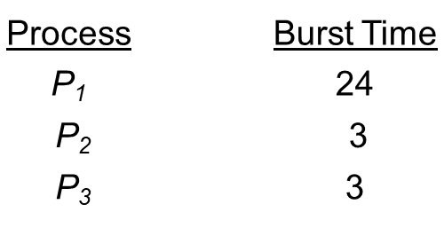
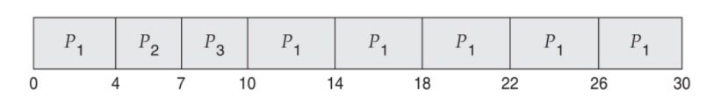
Example of RR with Time Quantum = 4
Typically, higher average turnaround than SJF, but better response
q should be large compared to context switch time
q usually 10ms to 100ms, context switch < 10 usec

Slide 19

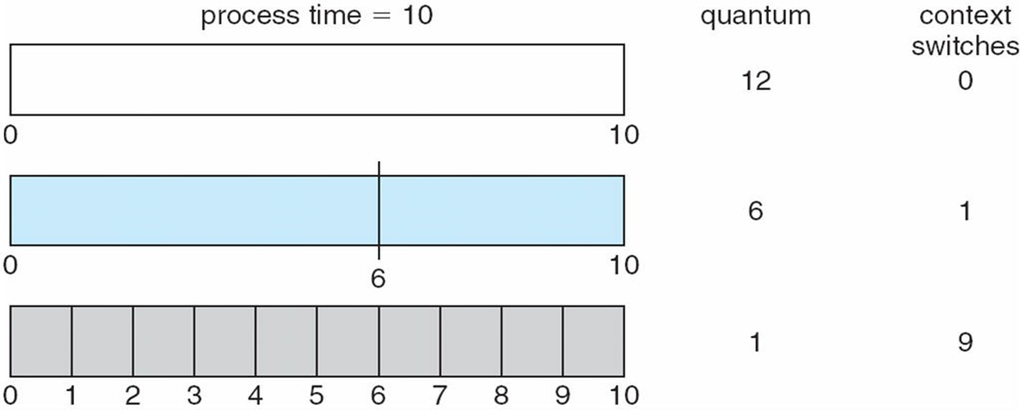

Slide 20
Multilevel Queue Scheduling
Ready queue is partitioned into separate queues, eg:
foreground (interactive)
background (batch)
Each queue has its own scheduling algorithm:
foreground – RR
background – FCFS

Slide 21
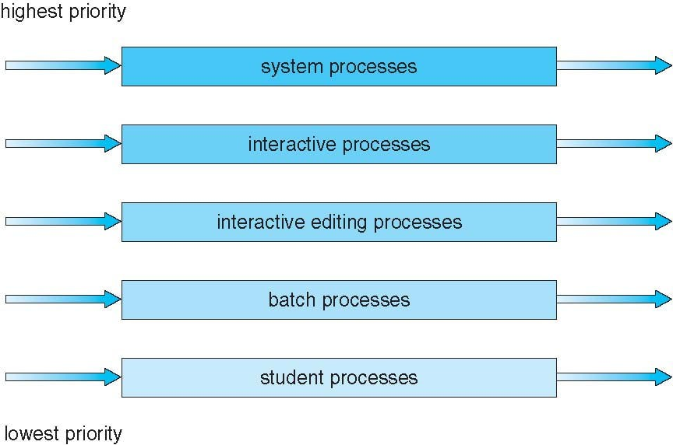
Multilevel Queue Scheduling

Slide 22
Cont..
Scheduling must be done between the queues:
Fixed priority scheduling; (i.e., serve all from foreground then from background). Possibility of starvation.
Time slice – each queue gets a certain amount of CPU time which it can schedule amongst its processes; i.e., 80% to foreground in RR, 20% to background in FCFS

Slide 23
Multilevel Feedback Queue
A process can move between the various queues; aging can be implemented this way
Multilevel-feedback-queue scheduler defined by the following parameters:
number of queues
scheduling algorithms for each queue
method used to determine when to upgrade a process
method used to determine when to demote a process
method used to determine which queue a process will enter when that process needs service

Slide 24
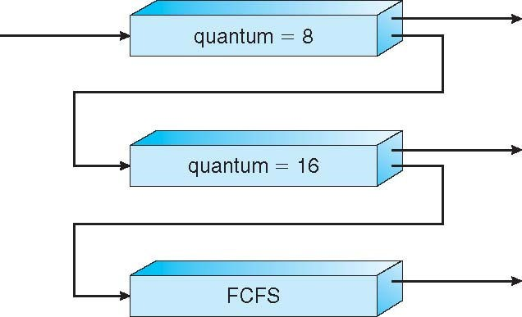
Example of Multilevel Feedback Queue
Three queues:
Q₀ – RR with time quantum 8 milliseconds
Q₁ – RR time quantum 16 milliseconds
Q₂ – FCFS
Scheduling
A new job enters queue Q₀ which is served FCFS
When it gains CPU, job receives 8 milliseconds
If it does not finish in 8 milliseconds, job is moved to queue Q₁
At Q₁ job is again served FCFS and receives 16 additional milliseconds
If it still does not complete, it is preempted and moved to queue Q₂

Slide 25
Thread Scheduling
Distinction between user-level and kernel-level threads
Many-to-one and many-to-many models, thread library schedules user-level threads to run on LWP
Known as process-contention scope (PCS) since scheduling competition is within the process
Typically done via priority set by programmer
Kernel thread scheduled onto available CPU is system-contention scope (SCS) – competition among all threads in system

Slide 26
Pthread Scheduling
API allows specifying either PCS or SCS during thread creation
PTHREAD_SCOPE_PROCESS schedules threads using PCS scheduling
PTHREAD_SCOPE_SYSTEM schedules threads using SCS scheduling
Can be limited by OS – Linux and Mac OS X only allow PTHREAD_SCOPE_SYSTEM

Slide 27
Pthread Scheduling API
#include <pthread.h>
#include <stdio.h>
#define NUM_THREADS 5
int main(int argc, char *argv[]) { int i, scope;
pthread_t tid[NUM THREADS];
pthread_attr_t attr;
/* get the default attributes */ pthread_attr_init(&attr);
/* first inquire on the current scope */
if (pthread_attr_getscope(&attr, &scope) != 0)
fprintf(stderr, "Unable to get scheduling scope\n");
else {
if (scope == PTHREAD_SCOPE_PROCESS) printf("PTHREAD_SCOPE_PROCESS");
else if (scope == PTHREAD_SCOPE_SYSTEM) printf("PTHREAD_SCOPE_SYSTEM");
else
fprintf(stderr, "Illegal scope value.\n");
}

Slide 28
Pthread Scheduling API
/* set the scheduling algorithm to PCS or SCS */ pthread_attr_setscope(&attr, PTHREAD_SCOPE_SYSTEM);
/* create the threads */
for (i = 0; i < NUM_THREADS; i++)
pthread_create(&tid[i],&attr,runner,NULL);
/* now join on each thread */
for (i = 0; i < NUM_THREADS; i++)
pthread_join(tid[i], NULL);
}
/* Each thread will begin control in this function */ void *runner(void *param)
{
/* do some work ... */ pthread_exit(0);
}

Slide 29
Multiple-Processor Scheduling
CPU scheduling more complex when multiple CPUs are available
Homogeneous processors within a multiprocessor
Asymmetric multiprocessing
Symmetric multiprocessing (SMP)
Example: Windows XP, Windows 2000,Solaris, Linux

Slide 30
Cont..
Processor affinity : process has affinity for processor on which it is currently running
soft affinity
hard affinity
Variations including processor sets

Slide 31
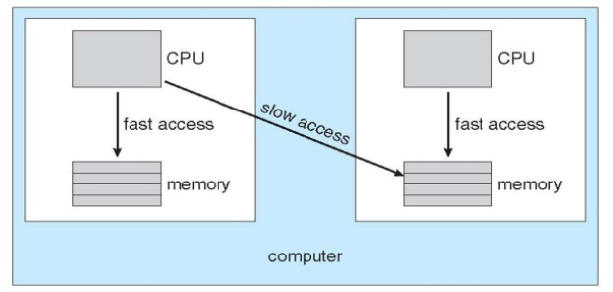
NUMA and CPU Scheduling

Slide 32
Load Balancing
If SMP, need to keep all CPUs loaded for efficiency
Load balancing : attempts to keep workload evenly distributed
Push migration : periodic task checks load on each processor, and if found pushes task from overloaded CPU to other CPUs
Pull migration : idle processors pulls waiting task from busy processor

Slide 33
Multicore Processors
Recent trend to place multiple processor cores on same physical chip
Faster and consumes less power
Multiple threads per core also growing
Takes advantage of memory stall to make progress on another thread while memory retrieve happens

Slide 34
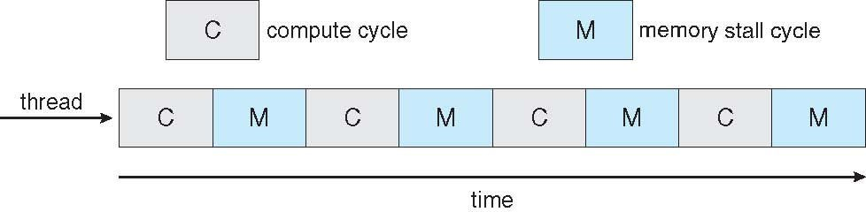

Cont..
Memory stall
Multithreaded multicore system

Slide 35
Algorithm evaluation
How to select CPU-scheduling algorithm for an OS?
Determine criteria, then evaluate algorithms

Slide 36
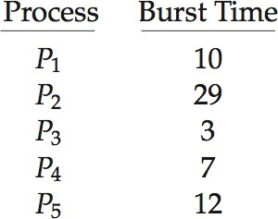
1. Deterministic modeling
Type of analytic evaluation
Takes a particular predetermined workload and defines the performance of each algorithm for that workload
Consider 5 processes arriving at time 0:

Slide 37
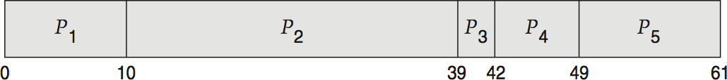
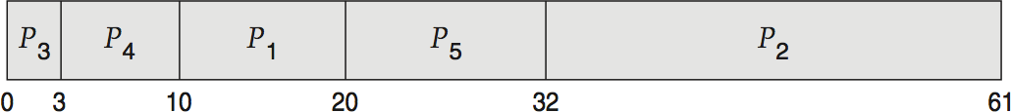
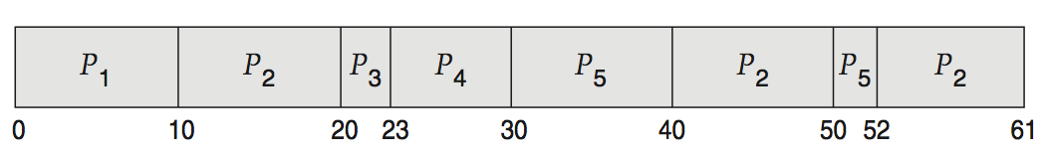
Cont..
For each algorithm, calculate minimum average waiting time
Simple and fast, but requires exact numbers for input, applies only to those inputs
FCS is 28ms:
Non-preemptive SJF is 13ms:
RR is 23ms:

Slide 38
2. Queueing Models
Describes the arrival of processes, and CPU and I/O bursts probabilistically
Computes average throughput, utilization, waiting time, etc
Knowing arrival rates and service rates
Computes utilization, average queue length, average wait time, etc

Slide 39
Little’s Formula
n = average queue length
W = average waiting time in queue
λ = average arrival rate into queue
Little’s law – in steady state, processes leaving queue must equal processes arriving, thus:
n = λ x W
Valid for any scheduling algorithm and arrival distribution

Slide 40
Cont..
For example, if on average 7 processes arrive per second, and normally 14 processes in queue, then average wait time per process = 2 seconds

Slide 41
3. Simulations
Queueing models limited
Simulations more accurate
Programmed model of computer system, Clock is a variable
Gather statistics indicating algorithm performance
Data to drive simulation gathered via Random number generator according to probabilities

Slide 42
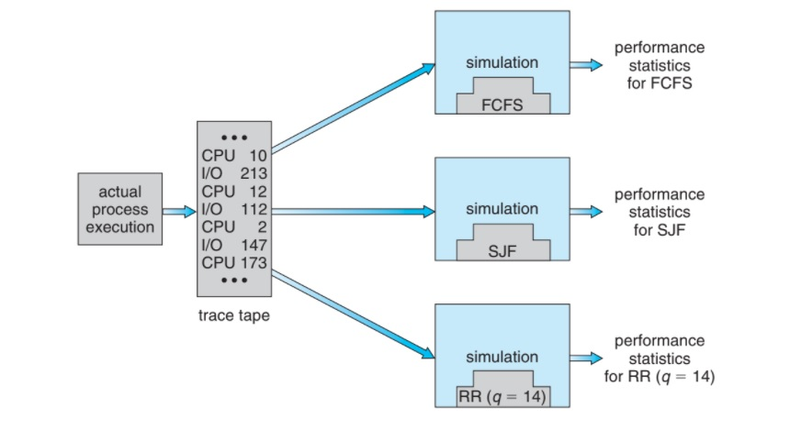
Evaluation of CPU Schedulers by Simulation

Slide 43
4.Implementation
Even simulations have limited accuracy
Just implement new scheduler and test in real systems
High cost, high risk
Environments vary
Most flexible schedulers can be modified per-site or per-system or APIs to modify priorities

Slide 44
Threads
A thread is a basic unit of CPU utilization; it comprises a thread ID, a program
counter, a register set, and a stack.
It shares with other threads belonging to the same process its code section, data section, and other operating-system resources, such as open files and signals.
A traditional (or heavyweight) process has a single thread of control.

Slide 45
Motivation
Most modern applications are multithreaded
Threads run within application
Multiple tasks with the application can be implemented by separate threads
Update display
Fetch data
Spell checking
Answer a network request
Process creation is heavy-weight while thread creation is light-weight

Slide 46
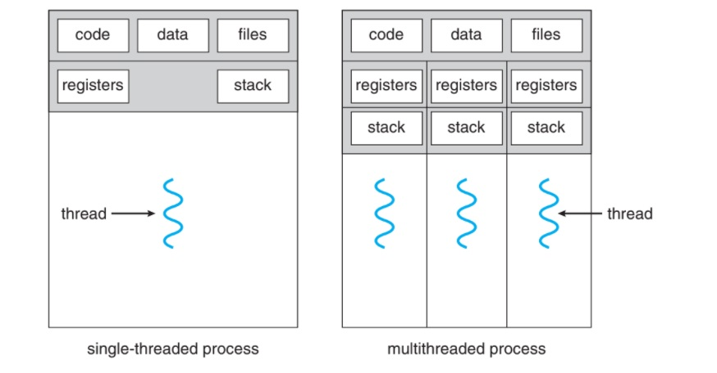
Single-threaded and multithreaded processes.

Slide 47
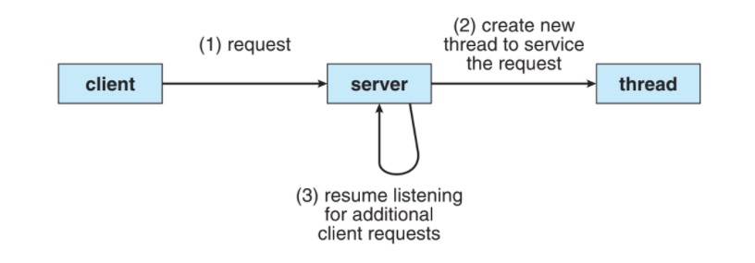
Multithreaded server architecture.

Slide 48
Benefits
Responsiveness
Resource Sharing
Economy
Scalability

Slide 49
Multicore Programming
Multicore or multiprocessor systems putting pressure on programmers, challenges include:
Dividing activities
Balance
Data splitting
Data dependency
Testing and debugging
Parallelism implies a system can perform more than one task simultaneously
Concurrency supports more than one task making progress
Single processor / core, scheduler providing concurrency

Slide 50
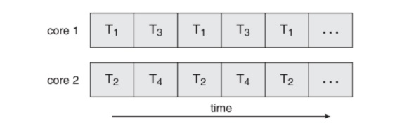
Cont..
Types of parallelism
Data parallelism – distributes subsets of the same data across multiple cores, same operation on each
Task parallelism – distributing threads across cores, each thread performing unique operation
As of threads grows, so does architectural support for threading
CPUs have cores as well as hardware threads
Consider Oracle SPARC T4 with 8 cores, and 8 hardware threads per core

Slide 51
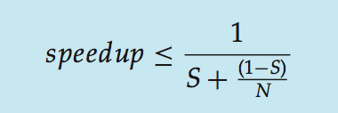
Amdahl’s Law
Identifies performance gains from adding additional cores to an application that has both serial and parallel components
S is serial portion, N processing cores
That is, if application is 75% parallel / 25% serial, moving from 1 to 2 cores results in speedup of 1.6 times
As N approaches infinity, speedup approaches 1 / S

Slide 52
User Threads and Kernel Threads
User threads - management done by user-level threads library
Three primary thread libraries:
POSIX Pthreads
Windows threads
Java threads
Kernel threads - Supported by the Kernel
Examples – virtually all general purpose operating systems, including:
Windows
Solaris
Linux
Tru64 UNIX
Mac OS X

Slide 53
Multithreading Models
Many-to-One
One-to-One
Many-to-Many

Slide 54
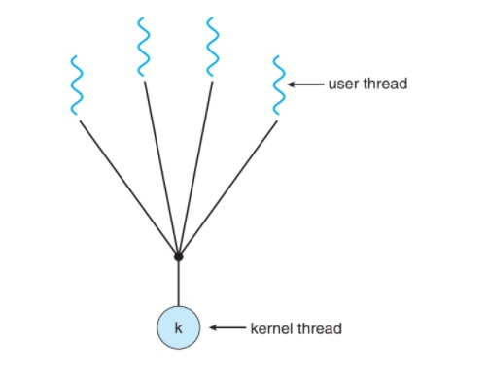
Many-to-One
Many user-level threads mapped to single kernel thread
One thread blocking causes all to block
Examples:
Solaris Green Threads
GNU Portable Threads

Slide 55
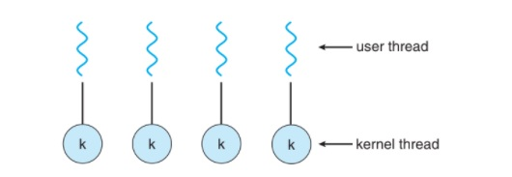
One-to-One
Each user-level thread maps to kernel thread
Creating a user-level thread creates a kernel thread
Examples
Windows
Linux
Solaris 9 and later

Slide 56
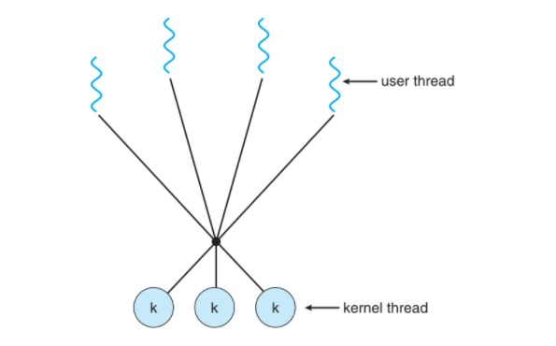
Many-to-Many Model
Allows many user level threads to be mapped to many kernel threads
Solaris prior to version 9
Windows with the ThreadFiber package

Slide 57
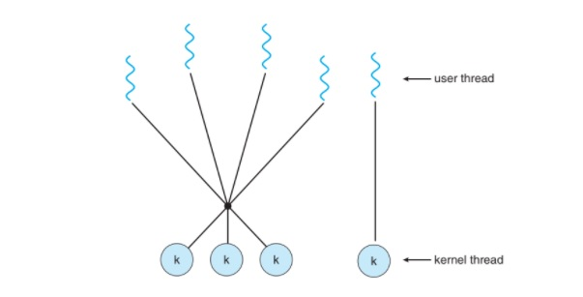
Two-level Model
Similar to M:M, except that it allows a user thread to be bound to kernel thread
Examples
IRIX
HP-UX
Tru64 UNIX
Solaris 8 and earlier

Slide 58
Thread Libraries
Thread library provides programmer with API for creating and managing threads
Two primary ways of implementing
Library entirely in user space
Kernel-level library supported by the OS

Slide 59
Pthreads
May be provided either as user-level or kernel-level
A POSIX standard (IEEE 1003.1c) API for thread creation and synchronization Specification, not implementation
API specifies behavior of the thread library
Implementation is up to development of the library
Common in UNIX operating systems (Solaris, Linux, Mac OS X)

Slide 60
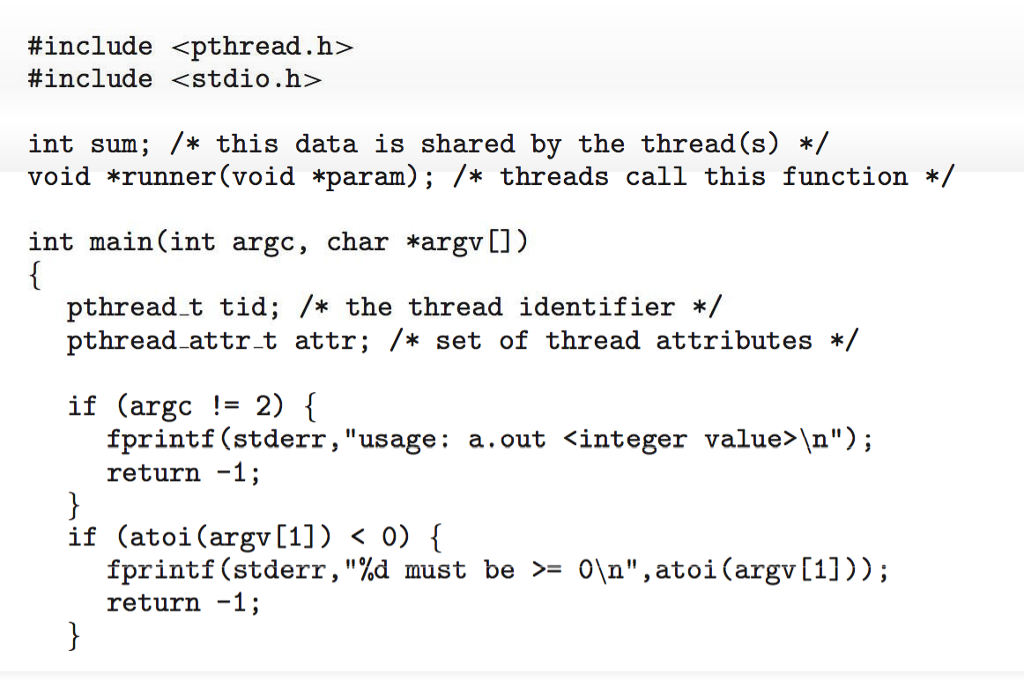
Pthreads Example

Slide 61
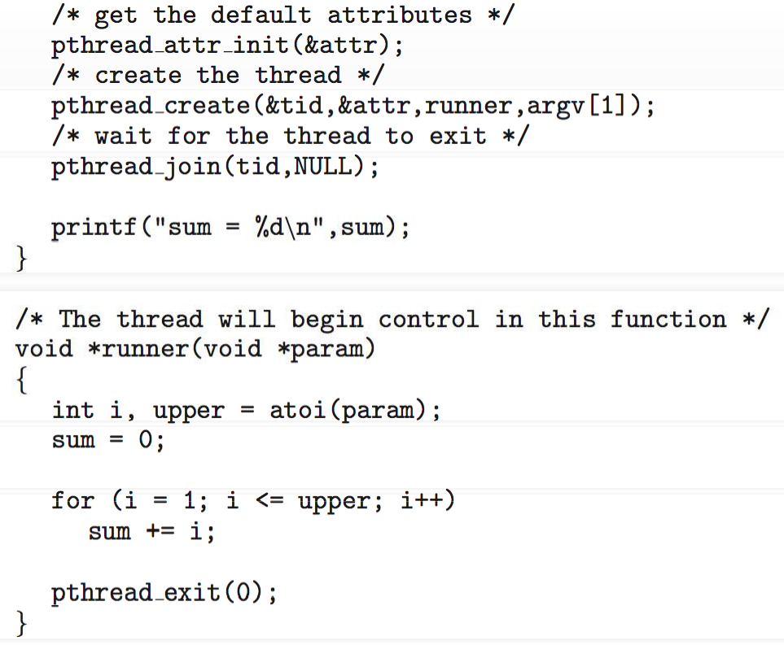

Slide 62
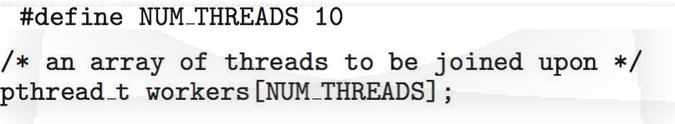
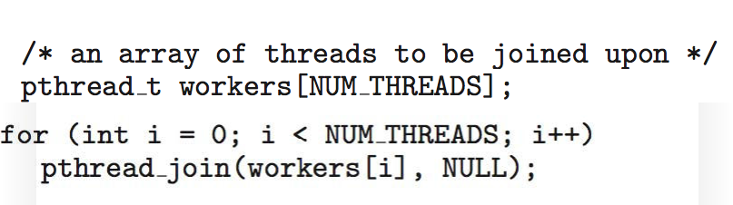

Slide 63
Windows Threads
The technique for creating threads using the Windows thread library is similar to the Pthreads technique in several ways.
Threads are created in the Windows API using the CreateThread() function

Slide 64
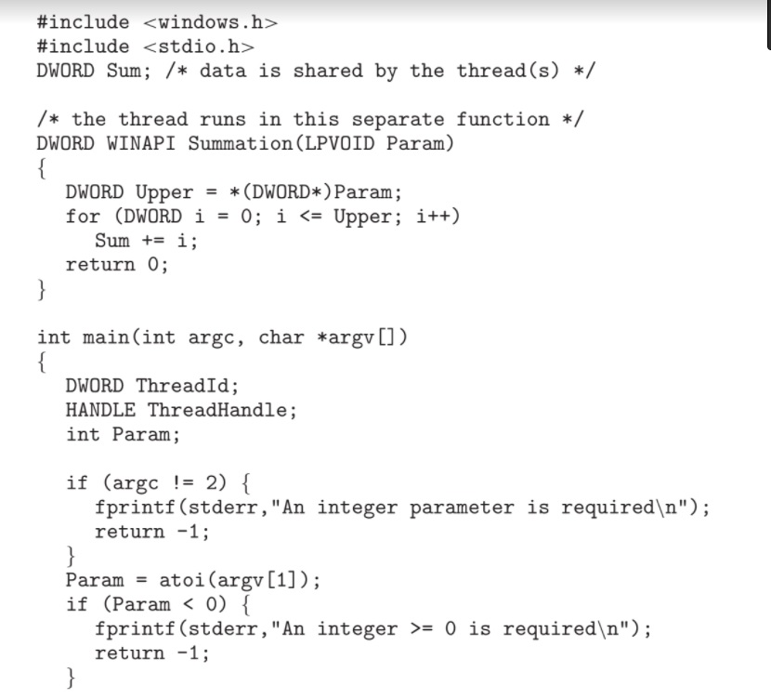

Slide 65
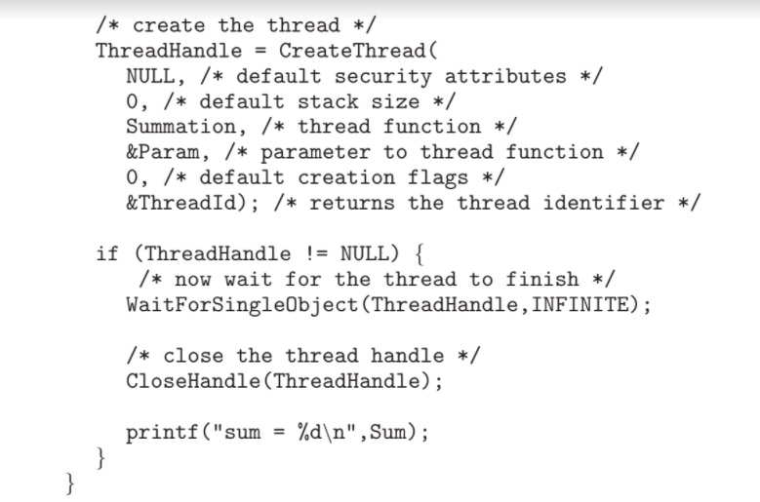

Slide 66
Java Threads
Threads are the fundamental model of program execution in a Java program,
and the Java language and its API provide a rich set of features for the creation
and management of threads.
All Java programs comprise at least a single thread of control—even a simple Java program consisting of only a main() method runs as a single thread in the JVM.

Slide 67
Cont..
There are two techniques for creating threads in a Java program.
One approach is to create a new class that is derived from the Thread class and to override its run() method. An alternative—and more commonly used— technique is to define a class that implements the Runnable interface.
The Runnable interface is defined as follows:
public interface Runnable
{
public abstract void run();
}

Slide 68
Cont..
Creating a Thread object does not specifically create the new thread; rather,
the start() method creates the new thread. Calling the start() method for
the new object does two things:
It allocates memory and initializes a new thread in the JVM.
It calls the run() method, making the thread eligible to be run by the JVM.

Slide 69
Thank You

